Slide 1
STATELess
REST Architectural Constraints

Slide 2

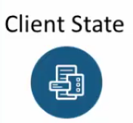


Stateless
No He Didn’t!
Notes:
--- in a typical web application when a client connect to a backend resource thru a (CLICK) mid-teir like tomcat (Server)
--- that connection creates a client session and that client session (CLICK) manages the application or the client state with in the mid-teir
---- all subsequent calls from the same client leads the mid-teir or the web application server to access this client or application state;
--- this client state management of the application state management is carried out by way of HTTP sessions (Typical way this is implemented)
---- For REST API this is not acceptable (CLICK)
--- so when you are designing REST API you have to keep stateless in mind (NEXT)

Slide 3
Designing a REST API
Client Request is independent
Server receives all info it needs in the request
Notes:
---- in designing a REST API
---- each client request must be independent and not know of any previous or future request made by the client
---- also the request sent by the client must have all the information that the server will need in order to process that request (NEXT)

Slide 4
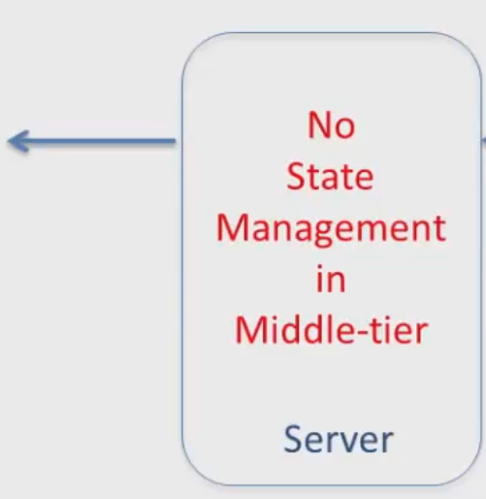
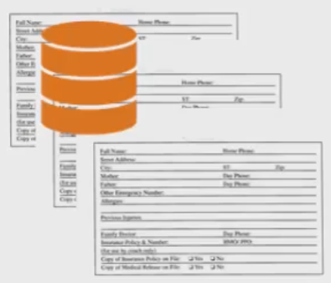
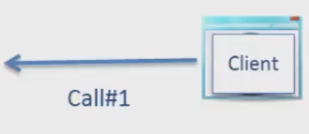
Making a REST API CAll
Manage State
Call #2
Notes:
--- (CLICK) co the client makes the first API request (CLICK) through the mid-teir (CLICK) to the back end
--- there is no state management carried out by the client or the mid-teir or the application server
--- if the client needs to manage the state, it will manage the state within the client (CLICK)
--- the request coming after the client has been set to Manage State mode, are managed within he client (CLICK) but there is no state management in the mid-teir

Slide 5
Summary
No state management in the mid tier or server
All calls from client are independent
Client sends all information sever needs to process request
Notes:
--- when you are designing a REST API you have to keep statelessness in mind, there are 3 important points to take care of
---- (CLICK) there is no state management in the mid teir or server allowed
---- (CLICK) all calls from client are independent, when a client makes a call or sends a request, that call or request has nothing to do with the previous call or request
---- (CLICK) the client sends all the information in the quest that the server will need to process the request
---- this is where the need for session management is eliminated

Slide 6

Questions and Answers

